Slide 1
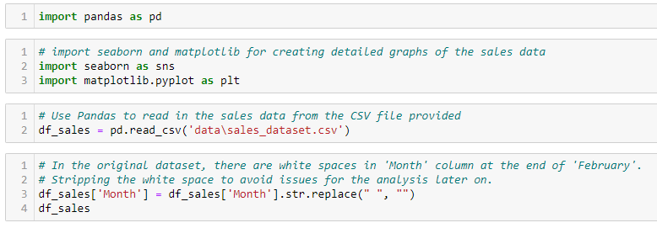
Use Pandas to read in the sales data from the CSV file provided (sales_dataset.csv)

Slide 2
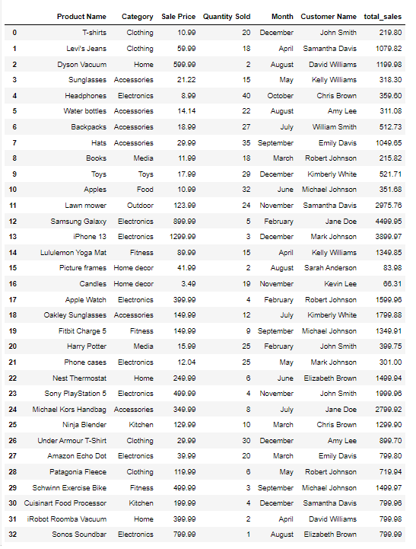

Slide 3
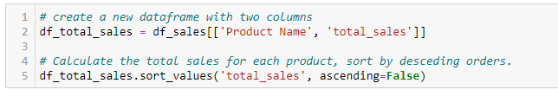
Calculate the total sales for each product

Slide 4
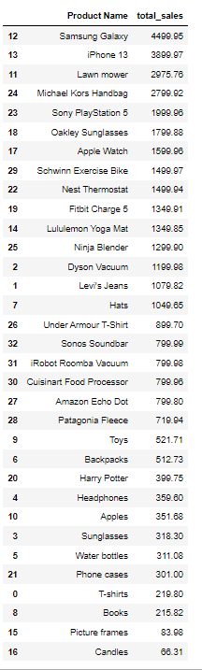

Slide 5
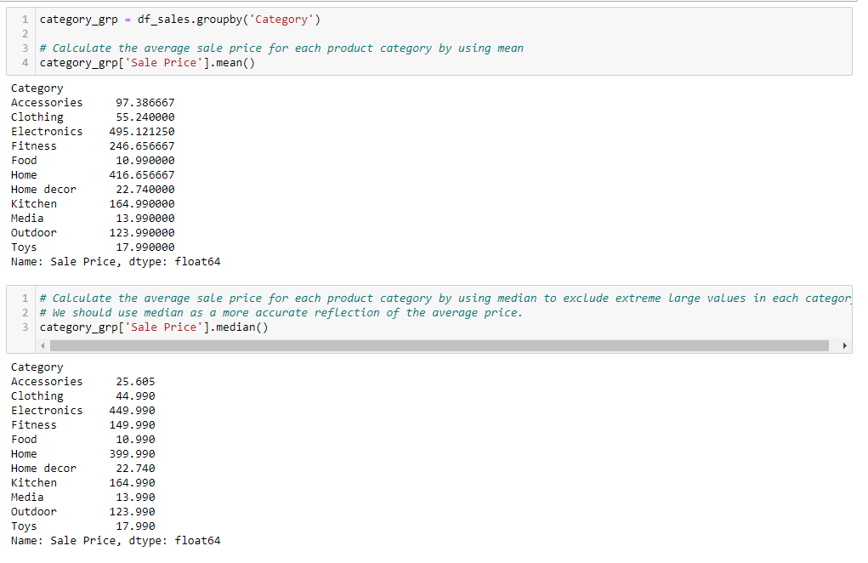
Determine the average sale price for each product category

Slide 6
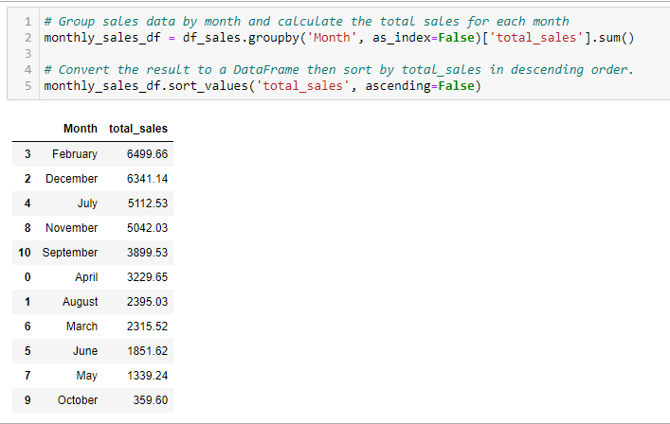
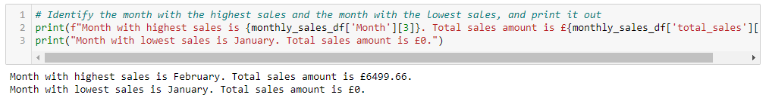
Identify the month with the highest sales and the month with the lowest sales

Slide 7
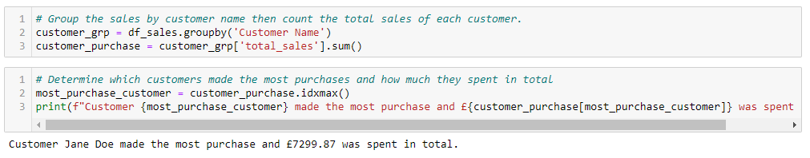
Determine which customers made the most purchases and how much they spent in total

Slide 8
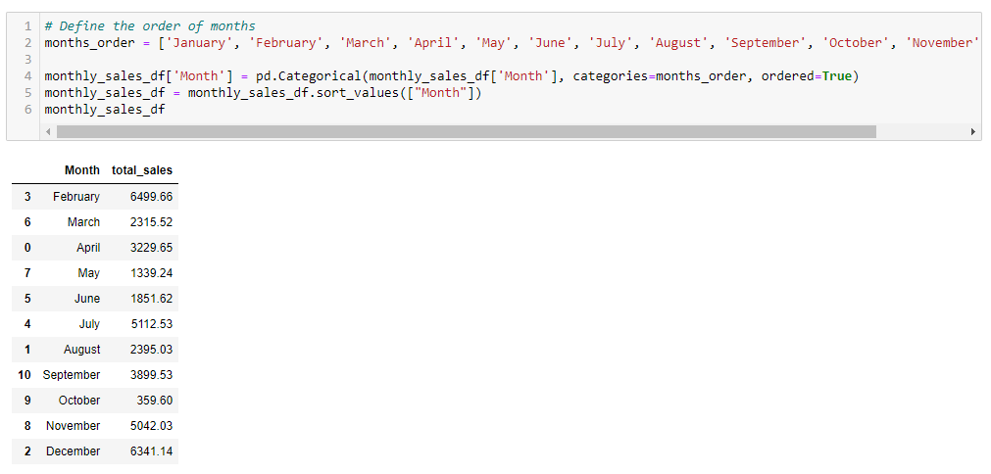
Use Matplotlib or Seaborn to create detailed graphs of the sales data

Slide 9
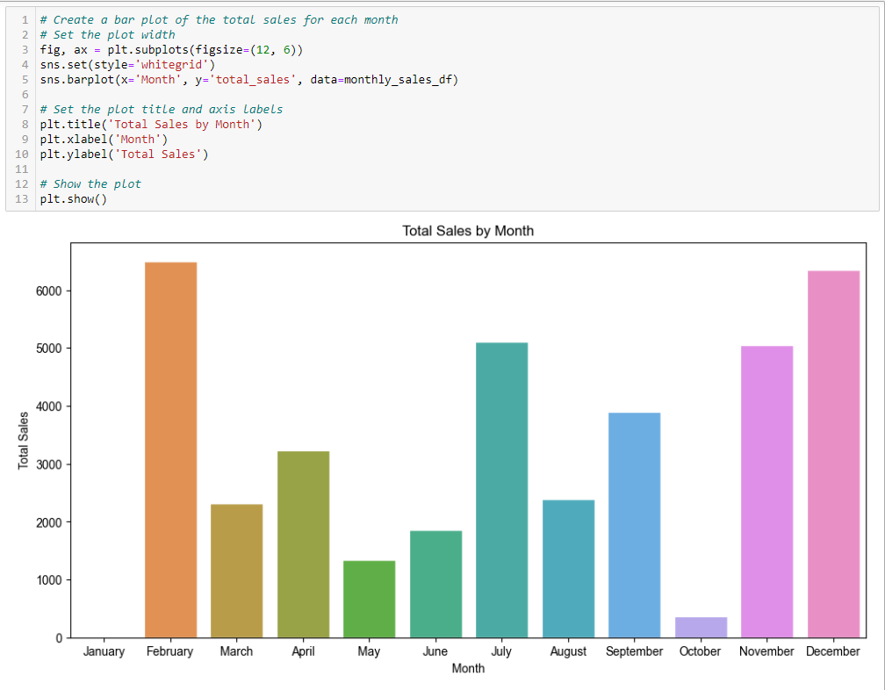

Slide 10
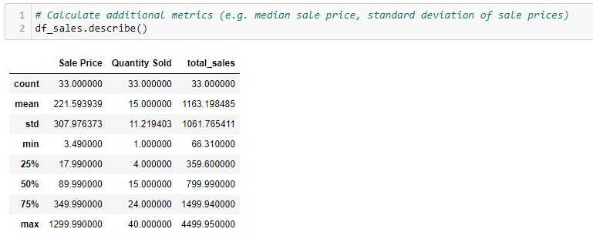
Calculate additional metrics (e.g. median sale price, standard deviation of sale prices)

